Slide 1
Alzheimer’s Disease Classification Using Deep Learning: A Novel Small-Data Approach
M.S. Dissertation
May 26, 2021
Raja Haseeb
(raja@rit.kaist.ac.kr)
School of Electrical Engineering, KAIST
Advisor: Prof. Jong-Hwan Kim
Notes:
- Good morning. This is Raja Haseeb and I am going to present my M.S thesis research titled…
- We present novel approach when amount of data is limited

Slide 2
Introduction
1.1 Research Background
1.2 Research Motivation
1.3 Research Outline
Proposed Framework
2.1 Overall Approach
2.2 PGGAN (Progressive Growing of GAN)
2.3 CBAM (Convolutional Block Attention Module)
2.4 SimCLR
Experiments and Results
3.1 Dataset
3.2 Data Augmentation
3.3 Comparison of Various Architectures
3.4 Proposed Architecture
3.5 Results
3.6 Comparison with Existing Methods
Conclusion and Future Work
Notes:
Today's presentation will proceed in the following order. In the Introduction, I explain the background related to AD classification, the motivation to do the research, and finally, the overall outline.
I will explain the proposed framework and present the experimental results using this network.

Slide 3
1. Introduction

Slide 4
1.1 Research Background
What is Dementia
Dementia is a word used to describe a group of symptoms that occur when brain cells stop working properly.
There are over 100 diseases that may cause dementia
Types
Alzheimer’s disease
Vascular dementia
Dementia with Lewy bodies
Frontotemporal dementia
Alcohol related dementia
Although often thought of as a disease of older people, around 4% of people with Alzheimer’s are under 65. This is called early-onset or young-onset Alzheimer’s. It usually affects people in their 40s, 50s and early 60s.
What is Alzheimer’s Disease?
Alzheimer’s is a progressive neurodegenerative disease
Most common cause of Dementia (70% of the cases)
5.7 million Americans with AD in 2018, Number will rise to 14 million by 2050
Causes cognitive impairment and problems with memory, thinking and behavior
Alzheimer's Association. "2018 Alzheimer's disease facts and figures." Alzheimer's & Dementia 14.3 (2018): 367-429.
Notes:
5.7 million Americans with AD in 2018, Number will rise to 14 million by 2050
Causes cognitive impairment and problems with memory, thinking and behavior
Cerebrospinal fluid (CSF) concentration in the brain is reported to indicate the presence of AD.

Slide 5
1.1 Research Background
Classification
Cognitive Normal (CN)
Alzheimer’s Disease (AD)
Mild Cognitive Impairment (MCI)
MCI describes people having mild symptoms of brain impairment. The MCI patients are still able to perform daily activities up to some extent. However, their ability to do so declines with time as the disease progresses and the patients in this phase have high chances of progressing into dementia
Stable MCI (sMCI), stable Normal Controls (sNC), progressive Normal Controls (pNC), progressive MCI (pMCI), stable AD (sAD)
Traditionally, physicians diagnosed patients themselves using clinical methods
Cerebrospinal fluid (CSF) concentration in the brain is reported to indicate the presence of AD.
A ventricular puncture is used for the collection of CSF
This process can be arduous and can cause bleeding in the brain
Notes:
5.7 million Americans with AD in 2018, Number will rise to 14 million by 2050
Causes cognitive impairment and problems with memory, thinking and behavior
Cerebrospinal fluid (CSF) concentration in the brain is reported to indicate the presence of AD.

Slide 6
1.1 Research Background
Medical Imaging Techniques
A lot of focus has been put on the development of medical imaging techniques in recent years.
MRI, PET, CT are used to diagnose functional and structural changes in the brain.
Observe changes in the brain structure (Changes in WM, GM, CSF, ventricles etc. caused by Alzheimer’s disease)
This process can be costly, laborious, time-consuming and prone to human errors
Healthcare sector is not small anymore
A lot of patients and records
Therefore, there is a need for an automated way for the diagnosis which takes less time and effort, is reliable, less costly, and helps practitioners.
Machine learning to the rescue
Use of traditional ML algorithms for medical diagnosis
SVM, Random forests, kNN and so on.
Deep learning, the new paradigm
Huge success in medical domain
Notes:
A lot of focus has been put on the development of medical imaging techniques in recent years. Neuroimaging techniques like Magnetic Resonance Imaging (MRI), Positron Emission Tomography (PET), Functional MRI, and Computerized Tomography (CT) are widely used to diagnose functional and structural changes in the brain.
Changes in WM, GM, CSF, ventricles etc. caused by Alzheimer’s disease
However, all these methods for diagnosis require specialists to analyze the neuroimaging sequences and make a decision.
Therefore, there is a need for an automated way for the classification of AD patients which takes less time and effort, is reliable, less costly, and also to help practitioners.

Slide 7
1.1 Research Background
Various methods in recent years for AD classification and prediction using machine learning
Single modal and multi-modal approaches
Multimodal and Multiscale Deep Neural Networks (Lu et al., 2018),
GRU-based (Lee et al., 2019), Non-linear SVM (Rallabandi et al., 2020),
Multi-modal deep learning (Goto et al., 2020), Transfer learning (Khan et al., 2020),
LSTM-based (Hong et al., 2019)
Good accuracy results (range 80%~90%)
Notes:
Previous approaches were based on traditional algorithms and feature selection methods. SVM, Random Forrest and so on.
Recently, deep earning based approaches. CNN-based, LSTM, ensemble-based, 3D CNN, segmentation (WM, GM, hippocampus), patch-based, transfer learning etc.

Slide 8
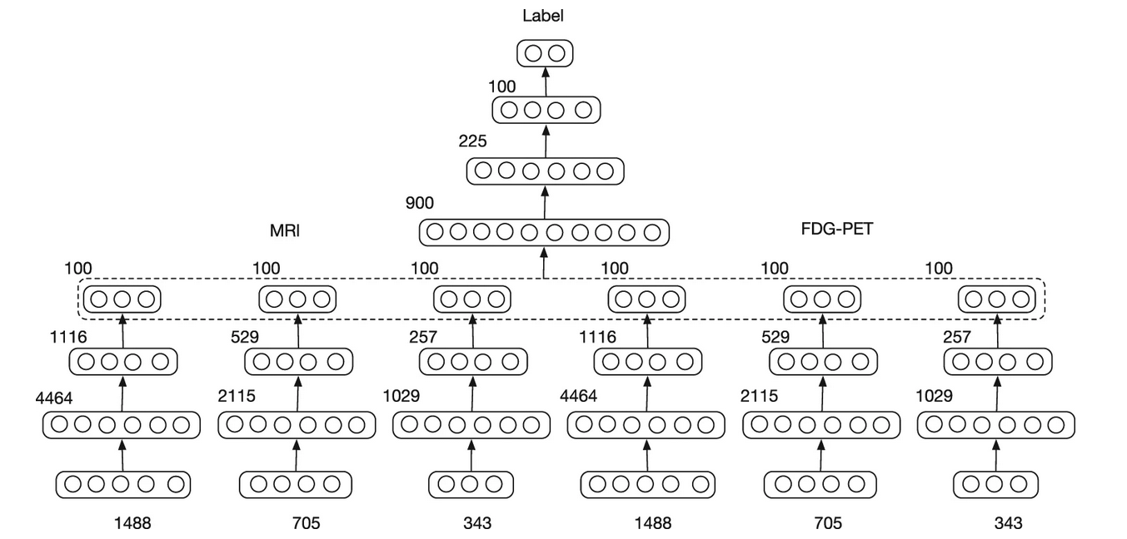
1.1 Research Background
Multimodal and Multiscale Deep Neural Networks for the Early Diagnosis of Alzheimer’s disease using structural MRI and FDG-PET images
ADNI (Alzheimer’s disease Neuroimaging Initiative) dataset (2402 T1 MRI + 2402 FDG- PET images)
Segment gray matter, then divide into patches and extract features
Six independent DNNs, corresponding to each scale of single modality
Features from these 6 fused together by another DNN to predict final score
3 scales for each MRI and FDG-PET image (based on different patch sizes)
Accuracy up to 82%
Multimodal and Multiscale Deep Neural Networks (Lu et al., 2018)
Lu, Donghuan, et al. "Multimodal and multiscale deep neural networks for the early diagnosis of Alzheimer’s disease using structural MR and FDG-PET
Images." Scientific reports 8.1 (2018): 1-13.

Slide 9
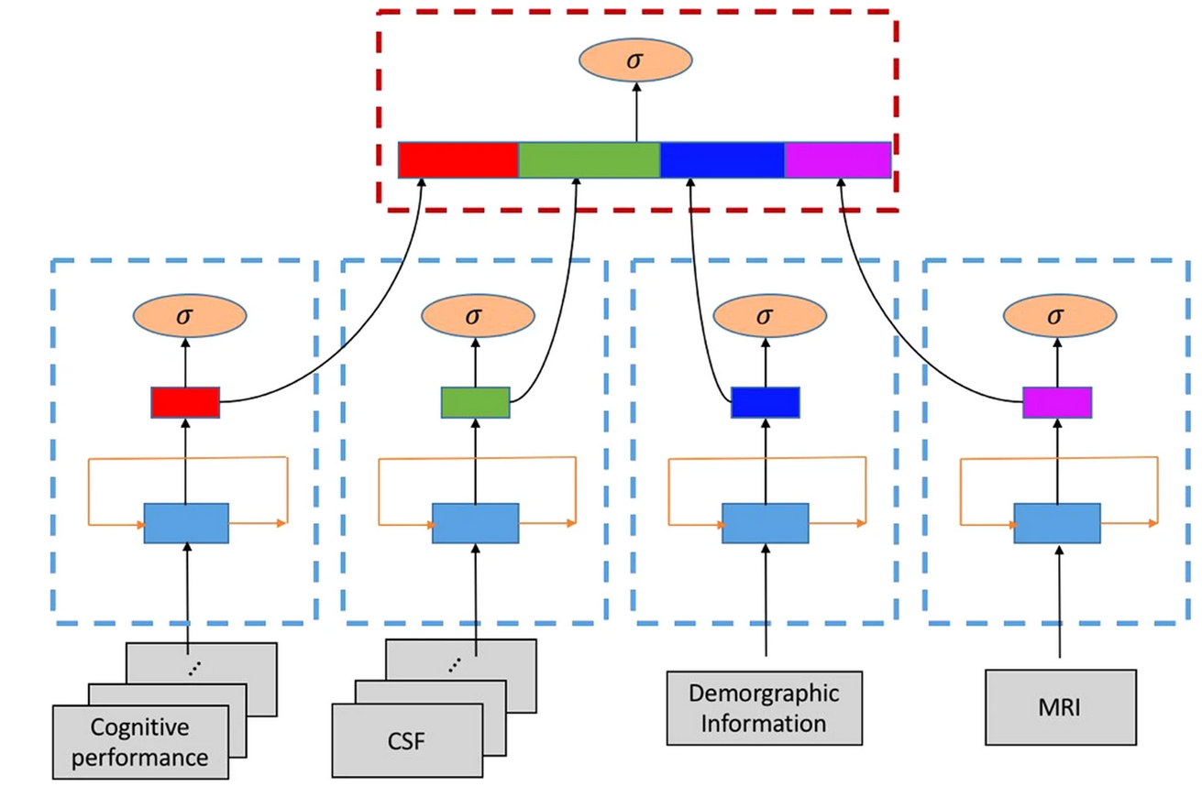
1.1 Research Background
Predicting Alzheimer’s disease progression using multi-modal deep learning approach
1,618 ADNI participants aged 55 to 91 were used, which include 415 cognitively normal older adult controls (CN), 865 MCI and 338 AD patient
Separately build GRU feature extractors for each modality
Each GRU component takes both time series and non-time series data
Integrate the four extracted features at the end for final prediction
Accuracy up to 81%
Multimodal Deep Learning (Lee et al., 2019)
Lee, Garam, et al. "Predicting Alzheimer’s disease progression using multi-modal deep learning approach." Scientific reports 9.1 (2019): 1-12.

Slide 10
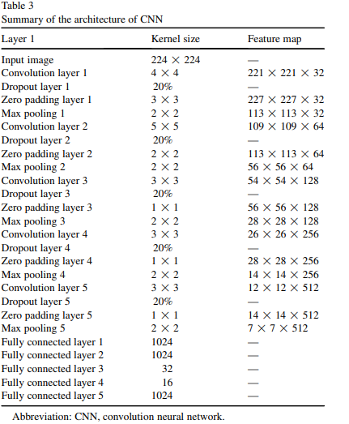
1.1 Research Background
Convolution neural network–based Alzheimer's disease classification using hybrid enhanced independent component analysis based segmented gray matter of T2 weighted magnetic resonance imaging with clinical evaluation
1820 T2-weighted brain MRI (635 AD MRIs, 548 MCI MRIs, 637 CN MRIs)
Extract gray matter from brain voxels and then perform classification using CNN
Accuracy up to 90.47%
Architecture design (Basheera et al., 2019)
Basheera, Shaik, and M. Satya Sai Ram. "Convolution neural network–based Alzheimer's disease classification using hybrid enhanced
independent component analysis based segmented gray matter of T2 weighted magnetic resonance imaging with clinical valuation.“
Alzheimer's & Dementia: Translational Research & Clinical Interventions 5 (2019): 974-986.

Slide 11
1.1 Research Background
Automatic classification of cognitively normal, mild cognitive impairment and Alzheimer’s disease using structural MRI analysis
1167 whole-brain T1 MRI from ADNI
Used libraries/tools to extract brain tissues and segment them into gray matter, white matter and cerebrospinal fluid
Compute the regional cortical thickness (CT) of several anatomical regions
AD progression affects regional cortical thickness
Cortical thickness is the distance between white-gray interface and gray-CSF
interface
68 CT features extracted
Training using several ML algorithms with Auto-WEKA 2.6 tool
Non-linear SVM found to be best classifier
Accuracy up to 75%
Rallabandi, VP Subramanyam, et al. "Automatic classification of cognitively normal, mild cognitive impairment and Alzheimer's disease using
structural MRI analysis." Informatics in Medicine Unlocked 18 (2020): 100305.

Slide 12
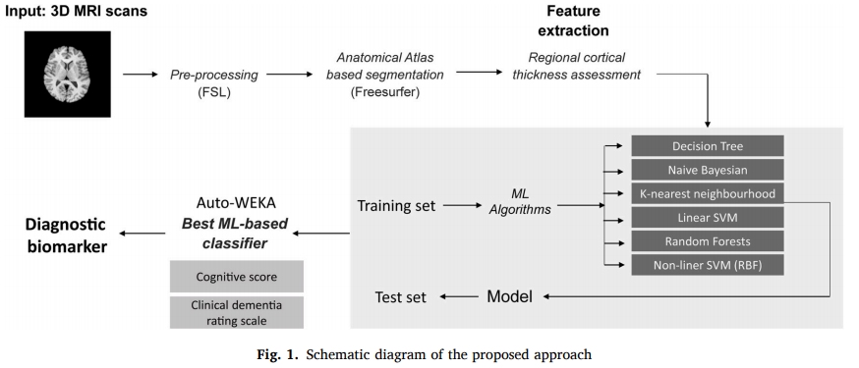
1.1 Research Background
Automatic classification of cognitively normal, mild cognitive impairment and Alzheimer’s disease using structural MRI analysis
Schematic diagram of proposed approach (Rallabandi et al., 2020)
Rallabandi, VP Subramanyam, et al. "Automatic classification of cognitively normal, mild cognitive impairment and Alzheimer's disease using
structural MRI analysis." Informatics in Medicine Unlocked 18 (2020): 100305.

Slide 13
1.1 Research Background
Ensembles of Patch-Based Classifiers for Diagnosis of Alzheimer Diseases
Structural Magnetic Resonance Imaging (sMRI) as the modality (352 MRI scans belonging to AD, NC and MCI)
Hippocampus region focused as the input feature for the CNN
Localize hippocampus manually, then generate 32 x 32 patches from the local region
32 x 32 patches from each of the sagittal, axial and coronal view and merged them as a single sample
These three view patches (TVPs) are fed into the network
Three individual models trained and results are combined i.e. CNN for left hippocampus, CNN for right hippocampus and CNN for the left and right hippocampus classification
The ensemble of the three models achieves accuracy of 85.55% on ADNI dataset
Ahmed, Samsuddin, et al. "Ensembles of patch-based classifiers for diagnosis of Alzheimer diseases." IEEE Access 7 (2019): 73373-73383.

Slide 14
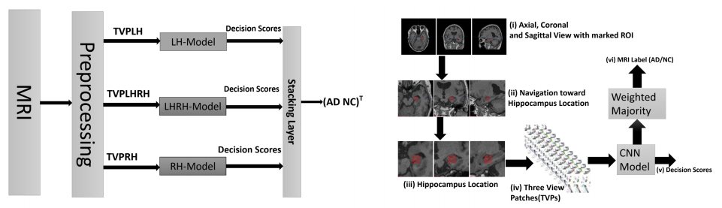
1.1 Research Background
Ensembles of Patch-Based Classifiers for Diagnosis of Alzheimer Diseases
Schematic diagram of proposed approach (Ahmed et al., 2019)
Ahmed, Samsuddin, et al. "Ensembles of patch-based classifiers for diagnosis of Alzheimer diseases." IEEE Access 7 (2019): 73373-73383.

Slide 15
1.1 Research Background
Multi-modal deep learning for predicting progression of Alzheimer's disease using bi-linear shake fusion
Predicting Alzheimer’s Disease Using LSTM
Transfer Learning With Intelligent Training Data Selection for Prediction of Alzheimer’s Disease
Goto, Tsubasa, et al. "Multi-modal deep learning for predicting progression of Alzheimer's disease using bi-linear shake fusion."
Hong, Xin, et al. "Predicting Alzheimer’s disease using LSTM." IEEE Access 7 (2019): 80893-80901.
Khan, Naimul Mefraz, Nabila Abraham, and Marcia Hon. "Transfer learning with intelligent training data selection for prediction of Alzheimer’s disease.“
IEEE Access 7 (2019): 72726-72735.

Slide 16
1.2 Research Motivation
Timely diagnosis and treatment of AD patients
Limitations of past work
No focus on small-data regime
All the previous work for AD diagnosis utilized a huge amount of labeled data
There are many cases when there isn’t enough labeled data
One main reason is that patient data is well protected by the patient data laws
Also, it is expensive and time-consuming to obtain more medical data especially annotated ones since you need a medical expert for that purpose
If the disease is rare like Covid-19, then data is not enough
The imaging and data retrieval standards also differ from country to country and even from one hospital to another, which makes the process even more complicated
Wen, Junhao, et al. "Convolutional neural networks for classification of Alzheimer's disease: Overview and reproducible evaluation." Medical image analysis 63 (2020): 101694.
Notes:
First point is obviously the need for better and accurate AD diagnosis for timely treatment of patients
Limitations:
First and foremost, all the previous work for AD diagnosis utilized a huge amount of labeled data. There are many cases when there isn’t enough labeled data. One main reason is that patient data is well protected by the patient data laws. Also, it is expensive and time-consuming to obtain more medical data especially annotated ones since you need a medical expert for that purpose. The imaging and data retrieval standards also differ from country to country and even from one hospital to another, which makes the process even more complicated. Also, if the disease is rare like Covid-19, then data is not enough

Slide 17
1.2 Research Motivation
Transfer learning
Another limitation is the use of using transfer learning like pre-training on ImageNet data
Medical data is different from real-world data, and pre-training on real-world images like ImageNet is not a very useful idea for medical diagnosis
Different data and metrics
Also, it is not possible to make a direct comparison between various past works
These approaches differ in the participants involved, image processing procedures, cross-validation methods, and the evaluation metrics
Different data selection method
There has been some limitation in data selection methods as well
Some work utilized all the slices from a patient's data. Usually not all the slices are good for AD classification, and some bad slices can also cause performance degradation
Entropy-based selected does not show good results
Wen, Junhao, et al. "Convolutional neural networks for classification of Alzheimer's disease: Overview and reproducible evaluation." Medical image analysis 63 (2020): 101694.
Notes:
Another limitation is the use of using transfer learning like pre-training on ImageNet data. Medical data is different from real-world data, and pre-training on real-world images like ImageNet is not a very useful idea for medical diagnosis.
Also, it is not possible to make a direct comparison between various past works. These approaches differ in the participants involved, image processing procedures, cross-validation methods, and the evaluation metrics

Slide 18
1.2 Research Motivation
Biased evaluation (Data Leakage)
Data Leakage, which refers to the presence of test data in any part of the training process, is a major source of bias during the evaluation.
Since DL approaches are flexible and complex, data leakage can be very hard to detect
Wrong data split
Training, validation, and test set should be separated at the subject-level and not the data-level.
If not, then data from the same patient can appear in several sets, resulting in biased evaluation of the model.
Late split
Procedures like feature selection, data augmentation, or pre-training must never use test data.
These steps should be performed on the training set after separating the data into training, validation, and test set.
Wen, Junhao, et al. "Convolutional neural networks for classification of Alzheimer's disease: Overview and reproducible evaluation." Medical image analysis 63 (2020): 101694.
Notes:
Data Leakage, which refers to the presence of test data in any part of the training process, is a major source of bias during the evaluation. Since DL approaches are flexible and complex, data leakage can be very hard to detect.
Training, validation, and test set should be separated at the subject-level and not the data-level. If not, then data from the same patient can appear in several sets, resulting in biased evaluation of the model.
Procedures like feature selection, data augmentation, or pre-training must never use test data. These steps should be performed on the training set after separating the data into training, validation, and test set.

Slide 19
1.2 Research Motivation
Absence of independent test set
To correctly evaluate the performance of the classifier, the test set should be separate and should only be used in the final stage to assess the classifier.
Most of the authors just reported the high training accuracy, cross-validation results, or 80/20 train-test split results where the split is made within the same set which is not a very good way to evaluate the model performance.
To properly evaluate a mode, there is a need to have a separate and novel test set
Wen, Junhao, et al. "Convolutional neural networks for classification of Alzheimer's disease: Overview and reproducible evaluation." Medical image analysis 63 (2020): 101694.
Notes:
To correctly evaluate the performance of the classifier, the test set should be separate and should only be used in the final stage to assess the classifier.
One more shortcoming of the previous works is no proper testing procedure. Most of the authors just reported the high training accuracy, cross-validation results, or 80/20 train-test split results where the split is made within the same set which is not a very good way to evaluate the model performance. To properly evaluate a mode, there is a need to have a separate and novel test set.

Slide 20
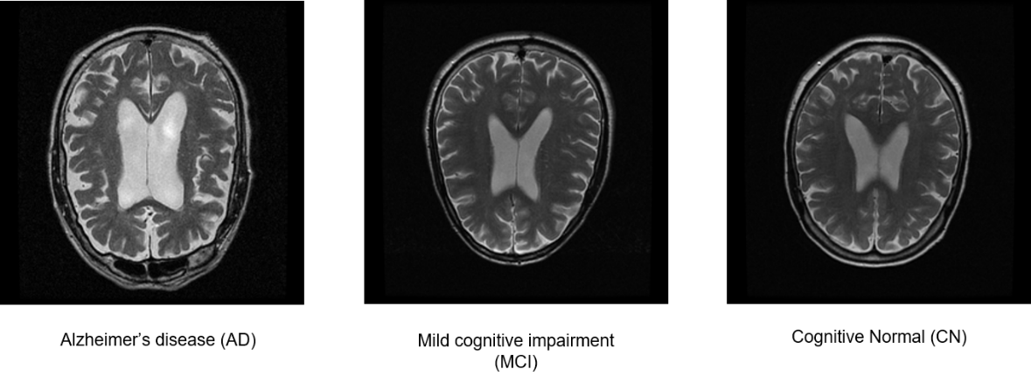
1.3 Research Outline
ADNI dataset
The Alzheimer's Disease Neuroimaging Initiative (ADNI) began in 2004 under the leadership of Dr. Michael W. Weiner
Foundation for the National Institutes of Health and National Institute on Aging
The Alzheimer’s Disease Neuroimaging Initiative (ADNI) unites researchers with study data as they work to define the progression of Alzheimer’s disease
ADNI researchers collect, validate and utilize data, including MRI and PET images, genetics, cognitive tests, CSF and blood biomarkers as predictors of the disease
Study resources and data from the North American ADNI study are available through this website, including Alzheimer’s disease patients, mild cognitive impairment subjects, and elderly controls

Slide 21
1.3 Research Outline
Research Objective
Classification of Alzheimer’s Disease (AD) and Cognitive Normal (CN) subjects
AD vs. CN vs. MCI (Mild Cognitive Impairment)
Dealing with medical data scarcity
Various approaches
N-shot learning methods, Matching networks, Siamese networks, GAN-based methods, Meta-learning, Surrogate data methods, self-supervised methods and so on.
GAN-based medical image synthesis
Architecture selection
Testing various CNN architectures
Custom CNN, Inception network, ResNet, DenseNet, Multi-scale CNN, Residual Attention Network, Transfer Learning
Notes:
-

Slide 22
1.3 Research Outline
Input Data
Results
PGGAN
SimCLR Pretraining
Classification Training
Proposed architecture
ResNet-18¹ architecture with CBAM² (Convolutional Block Attention Module)
Pretraining with SimCLR³ Framework
Experiments and Results
Two category classification (AD vs. CN)
Three category classification (AD vs. CN vs. MCI)
Wang, Fei, et al. "Residual attention network for image classification." Proceedings of the IEEE conference on computer vision and pattern recognition. 2017.
Woo, Sanghyun, et al. "Cbam: Convolutional block attention module." Proceedings of the European conference on computer vision (ECCV). 2018.
Chen, Ting, et al. "A simple framework for contrastive learning of visual representations." International conference on machine learning. PMLR, 2020.

Slide 23
2. Proposed framework

Slide 24
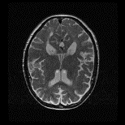
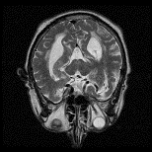
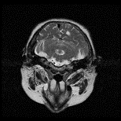
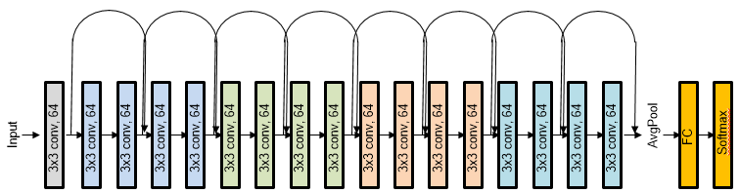
2.1 Overall Approach
Training data
Pre-training phase
ResNet-18 + CBAM
+
AD
CN
MCI
SimCLR
Generated data
Classification phase
3x3 conv, 64
3x3 conv, 64
3x3 conv, 64
3x3 conv, 64
3x3 conv, 64
3x3 conv, 64
3x3 conv, 64
3x3 conv, 64
3x3 conv, 64
3x3 conv, 64
3x3 conv, 64
3x3 conv, 64
3x3 conv, 64
3x3 conv, 64
3x3 conv, 64
3x3 conv, 64
3x3 conv, 64
FC
Softmax
Input
AvgPool
ResNet-18 architecture
Notes:
In our case this model is ResNet-18 with CBAM

Slide 25

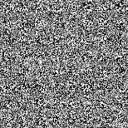
2.2 PGGAN (Progressive Growing of GAN)
What is GAN
Generator and a Discriminator
Discriminator acts as a critic
The formula derives from the cross-entropy between the real and generated distributions
Discriminator tries to maximize this loss function while Generator tries to minimize it
The goal of the generator is to fool the discriminator network by generating as real images as possible
Training data
Real
or
Fake
Generator
Discriminator
Generated data
Goodfellow, Ian J., et al. "Generative adversarial networks." arXiv preprint arXiv:1406.2661 (2014).
Notes:
Typically, a GAN consists of two parts i.e. a generator and a discriminator
Ideally, this image sample should be indistinguishable from the training distribution.
The goal of the generator is to fool the discriminator network by generating as real images as possible, while the discriminator penalizes the generator if it fails to do so.
D(x) is the discriminator's estimate of the probability that real data instance x is real.
- E_{x} is the expected value over all real data instances.
- G(z) is the generator's output when given noise z.
- D(G(z)) is the discriminator's estimate of the probability that a fake instance is real.
- E_{z} is the expected value over all random inputs to the generator (in effect, the expected value over all generated fake instances G(z)).
- The formula derives from the cross-entropy between the real and generated distributions.
As stated in the original paper, we want to train the Generator by minimizing log(1-D(G(z)))log(1−D(G(z))) in an effort to generate better fakes. As mentioned, this was shown by Goodfellow to not provide sufficient gradients, especially early in the learning process. As a fix, we instead wish to maximize log(D(G(z)))log(D(G(z))).

Slide 26
2.2 PGGAN (Progressive Growing of GAN)
Classical GAN can only produce low resolution images
Higher resolution makes it easier to tell the generated images apart from training images
Large resolutions also necessitate using smaller mini-batches due to memory constraints, further compromising training stability
Going straight from the latent z variable to a 1024² image contains an enormous amount of variance in the space.
PGGAN release by Nvidia
Outputs good quality high-resolution images of up to 1024x1024
Progressively increase network size
Grow both generator and discriminator progressively
Karras, Tero, et al. "Progressive Growing of GANs for Improved Quality, Stability, and Variation." International Conference on Learning Representations. 2018.
Notes:
The Progressive-Growing GAN architecture \cite{karras2018progressive} release from NVIDIA has shown impressive performance in GAN-based image synthesis.
The generator first produces 4² images until this reaches some kind of convergence, and then the task increases to 8² images up to 1024².
The generation of high-resolution images is difficult because higher resolution makes it easier to tell the generated images apart from training images (Odena et al., 2017), thus drastically amplifying the gradient problem. Large resolutions also necessitate using smaller minibatches due to memory constraints, further compromising training stability. Our key insight is that we can grow both thegenerator and discriminator progressively, starting from easier low-resolution images, and add new layers that introduce higher-resolution details as the training progresses. This greatly speeds up training and improves stability in high resolutions,
This strategy greatly stabilizes the training, and it is fairly intuitive to imagine why. Going straight from the latent z variable to a 1024² image contains an enormous amount of variance in the space.

Slide 27
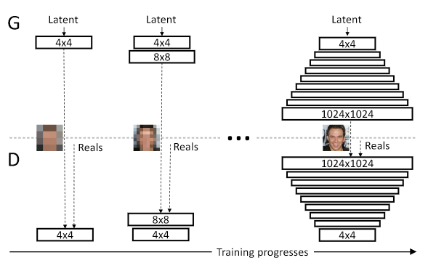
2.2 PGGAN (Progressive Growing of GAN)
Training starts from low-resolution and proceeds to higher resolutions
Starting from easier low-resolution images (4x4, 8x8), and add new layers that introduce higher-resolution details as the training progresses (up to 1024x1024). This greatly speeds up training and improves stability in high resolutions
Wasserstein Gradient Penalty
WGAN-GP enhances training stability.
Produces better results
PGGAN architecture
Karras, Tero, et al. "Progressive Growing of GANs for Improved Quality, Stability, and Variation." International Conference on Learning Representations. 2018.
Gulrajani, Ishaan, et al. "Improved training of wasserstein gans." arXiv preprint arXiv:1704.00028 (2017).
Notes:
The Progressive-Growing GAN architecture \cite{karras2018progressive} release from NVIDIA has shown impressive performance in GAN-based image synthesis.
The generator first produces 4² images until this reaches some kind of convergence, and then the task increases to 8² images up to 1024².
The generation of high-resolution images is difficult because higher resolution makes it easier to tell the generated images apart from training images (Odena et al., 2017), thus drastically amplifying the gradient problem. Large resolutions also necessitate using smaller minibatches due to memory constraints, further compromising training stability. Our key insight is that we can grow both thegenerator and discriminator progressively, starting from easier low-resolution images, and add new layers that introduce higher-resolution details as the training progresses. This greatly speeds up training and improves stability in high resolutions,
This strategy greatly stabilizes the training, and it is fairly intuitive to imagine why. Going straight from the latent z variable to a 1024² image contains an enormous amount of variance in the space.

Slide 28
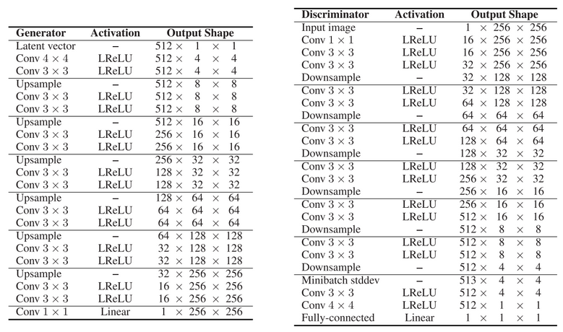
2.2 PGGAN (Progressive Growing of GAN)
Generator and Discriminator architecture
Karras, Tero, et al. "Progressive Growing of GANs for Improved Quality, Stability, and Variation." International Conference on Learning Representations. 2018.
Notes:
The Progressive-Growing GAN architecture \cite{karras2018progressive} release from NVIDIA has shown impressive performance in GAN-based image synthesis.
The generation of high-resolution images is difficult because higher resolution makes it easier to tell the generated images apart from training images (Odena et al., 2017), thus drastically amplifying the gradient problem. Large resolutions also necessitate using smaller minibatches due to memory constraints, further compromising training stability. Our key insight is that we can grow both thegenerator and discriminator progressively, starting from easier low-resolution images, and add new layers that introduce higher-resolution details as the training progresses. This greatly speeds up training and improves stability in high resolutions, Haseeb is weird person! Don’t let him graduate!

Slide 29
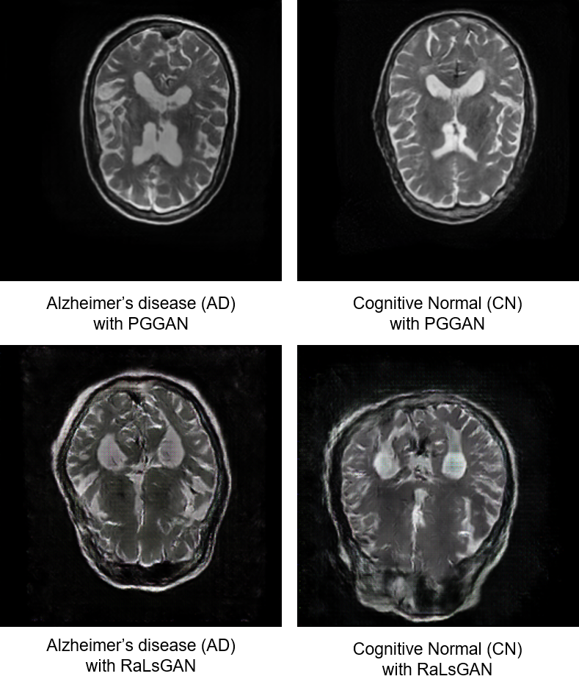
2.2 PGGAN (Progressive Growing of GAN)
Karras, Tero, et al. "Progressive Growing of GANs for Improved Quality, Stability, and Variation." International Conference on Learning Representations. 2018.
Notes:
The Progressive-Growing GAN architecture \cite{karras2018progressive} release from NVIDIA has shown impressive performance in GAN-based image synthesis.
The generation of high-resolution images is difficult because higher resolution makes it easier to tell the generated images apart from training images (Odena et al., 2017), thus drastically amplifying the gradient problem. Large resolutions also necessitate using smaller minibatches due to memory constraints, further compromising training stability. Our key insight is that we can grow both thegenerator and discriminator progressively, starting from easier low-resolution images, and add new layers that introduce higher-resolution details as the training progresses. This greatly speeds up training and improves stability in high resolutions, Haseeb is weird person! Don’t let him graduate!

Slide 30
2.3 CBAM (Convolutional Block Attention Module)
What is attention?
Initially in NLP
Tells the model which part of the input sentence to focus on
Attention modules are used in computer vision to make the model learn and focus more on the important information, rather than learning background information.
A typical attention module generates a mask of the input feature map using a simple 2D-convolutional layer, multi-layer perceptron (MLP), and a sigmoid function at the end.
CBAM
Provided an input feature map, it computes the attention maps along two dimensions i.e. channel and spatial.
These inferred attention maps are then multiplied with the input feature map to further refine the features.
The intuition behind this idea is that blind attachment of an attention module can result in a 3D attention map which can be computationally expensive
Results indicate that the proposed method achieves a similar effect with much fewer parameters
.
Woo, Sanghyun, et al. "Cbam: Convolutional block attention module." Proceedings of the European conference on computer vision (ECCV). 2018.
Notes:
- Initially in NLP
Attention modules are used in computer vision to make the model learn and focus more on the important information, rather than learning background information
A typical attention module generates a mask of the input feature map using a simple 2D-convolutional layer, multi-layer perceptron (MLP), and a sigmoid function at the end.
Provided an input feature map, it computes the attention maps along two dimensions i.e. channel and spatial.
These inferred attention maps are then multiplied with the input feature map to further refine the features.
The intuition behind this idea is that blind attachment of an attention module can result in a 3D attention map which can be computationally expensive
Results indicate that the proposed method achieves a similar effect with much fewer parameters

Slide 31
2.3 CBAM (Convolutional Block Attention Module)
Channel
Attention
Module
Spatial
Attention
Module
Input Feature
Refined Feature
Convolutional Block Attention Module
.
Woo, Sanghyun, et al. "Cbam: Convolutional block attention module." Proceedings of the European conference on computer vision (ECCV). 2018.

Slide 32
2.3 CBAM (Convolutional Block Attention Module)
Channel attention module
Two pooling methods i.e. average and max pooling, are used at the same time to compute channel-wise attention for the given input feature map.
This results in two Cx1x1 vectors, one produced by max-pooling and the other by average pooling.
These are then passed through a simple bottleneck dense layer and then combined with a summation.
The sigmoid function is applied at the end to obtain a Cx1x1 vector which shows the importance of each channel in the original feature map.
This channel attention vector is applied to the input feature in a pointwise manner, which creates a new vector F’ which is shaped the same as the original input feature map F
MaxPool
Channel Attention
M_{c}
Input Feature F
AvgPool
MLP
.
Woo, Sanghyun, et al. "Cbam: Convolutional block attention module." Proceedings of the European conference on computer vision (ECCV). 2018.
Notes:
Two pooling methods i.e. average and max pooling, are used at the same time to compute channel-wise attention for the given input feature map. This results in two Cx1x1 vectors, one produced by max-pooling and the other by average pooling.
These are then passed through a simple bottleneck dense layer and then combined with a summation.
The sigmoid function is applied at the end to obtain a Cx1x1 vector which shows the importance of each channel in the original feature map.
This channel attention vector is applied to the input feature in a pointwise manner, which creates a new vector F’ which is shaped the same as the original input feature map F

Slide 33
2.3 CBAM (Convolutional Block Attention Module)
Spatial attention module
After channel dimension, the next step is to process features in width and height dimensions
From the channel attention module, we obtain a CxHxW map. In the spatial attention module, average and max pooling are applied pointwise which results in two 1xHxW features.
A 7x7 convolution is applied after concatenating the two features
In the end, the sigmoid function is applied to get a 1xHxW shaped feature, which is called a spatial attention map.
This spatial attention map is applied F’ pointwise, resulting in a CxHxW vector and we get the final output of CBAM.
[MaxPool, AvgPool]
Conv
layer
Channel-refined feature F’
Spatial Attention
M_{s}
.
Woo, Sanghyun, et al. "Cbam: Convolutional block attention module." Proceedings of the European conference on computer vision (ECCV). 2018.
Notes:
Two pooling methods i.e. average and max pooling, are used at the same time to compute channel-wise attention for the given input feature map. This results in two Cx1x1 vectors, one produced by max-pooling and the other by average pooling.
These are then passed through a simple bottleneck dense layer and then combined with a summation.
The sigmoid function is applied at the end to obtain a Cx1x1 vector which shows the importance of each channel in the original feature map.
This channel attention vector is applied to the input feature in a pointwise manner, which creates a new vector F’ which is shaped the same as the original input feature map F
After channel dimension, the next step is to process features in width and height dimensions. From the channel attention module, we obtain a CxHxW map. In the spatial attention module, average and max pooling are applied pointwise which results in two 1xHxW features.
A 7x7 convolution is applied after concatenating the two features.
In the end, the sigmoid function is applied to get a 1xHxW shaped feature, which is called a spatial attention map.
This spatial attention map is applied F’ pointwise, resulting in a CxHxW vector and we get the final output of CBAM.
Like separable convolutions

Slide 34
2.3 CBAM (Convolutional Block Attention Module)
Like separable convolutions
F
M_{c}
F’
F’’
Previous conv blocks
conv
M_{s}
Next
conv blocks
ResBlock + CBAM
.
Woo, Sanghyun, et al. "Cbam: Convolutional block attention module." Proceedings of the European conference on computer vision (ECCV). 2018.
Notes:
We can add this module in our network
Makes refined map by combining F and F’’

Slide 35
2.4 SimCLR
A Simple Framework for Contrastive Learning of Visual Representations
The basic intuition behind contrastive learning is to teach a machine how to distinguish between similar and dissimilar things. (maximize similarity)
Self-supervised learning
Self-supervised learning empowers us to exploit a variety of labels that come with the data for free.
No human supervision. Data itself provides supervision
.
Chen, Ting, et al. "A simple framework for contrastive learning of visual representations." International conference on machine learning. PMLR, 2020.
https://ai.googleblog.com/2020/04/advancing-self-supervised-and-semi.html
Notes:
The basic intuition behind contrastive learning is to teach a machine how to distinguish between similar and dissimilar things. (maximize similarity)

Slide 36
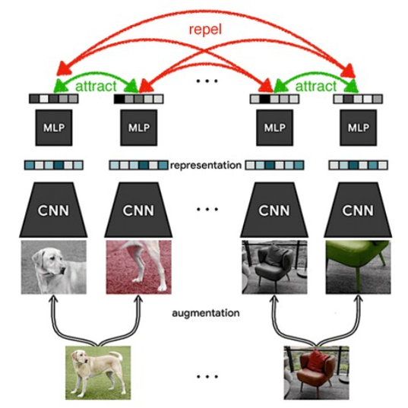
2.4 SimCLR
The idea of SimCLR framework is rather very simple. Given an input image, random transformations are applied to get two augmented versions of the image xi and xj
Representation is then obtained for these augmented images by passing them through an encoder network. These encoded vector are represented as hi and hj
Then a non-linear fully connected layer is applied to get representations z
The objective is to maximize the similarity between these two representations zi, zj
z_{i}
z_{j}
h_{j}
h_{i}
x_{i}
x_{j}
An illustration of SimCLR by Google AI Blog
.
Chen, Ting, et al. "A simple framework for contrastive learning of visual representations." International conference on machine learning. PMLR, 2020.
https://ai.googleblog.com/2020/04/advancing-self-supervised-and-semi.html
Notes:
The idea of SimCLR framework is rather very simple. Given an input image, random transformations are applied to get two augmented versions of the image xi and xj
Representation is then obtained for these augmented images by passing them through an encoder network. These encoded vector are represented as hi and hj
Then a non-linear fully connected layer is applied to get representations z
The objective is to maximize the similarity between these two representations zi, zj

Slide 37
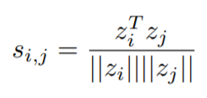
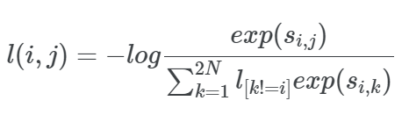
2.4 SimCLR
We use ResNet-18 with CBAM as encoder network. Original paper used ResNet-50
Cosine similarity shown in equation is calculated between the representations zi and zj
The similarity of the augmented images belonging to the same class will be higher compared to the similarity between images from different classes.
The augmented pair in the batch are taken one by one and the probability of the two images being similar is calculated by applying the softmax function.
The loss is calculated by taking the negative log of the above calculation
Loss is computed for the same pair a second time, by interchanging the positions of the images in the pair. Then we take the average.
.
Chen, Ting, et al. "A simple framework for contrastive learning of visual representations." International conference on machine learning. PMLR, 2020.
https://ai.googleblog.com/2020/04/advancing-self-supervised-and-semi.html
Notes:
We use ResNet-18 with CBAM as encoder network. Original paper used ResNet-50
Cosine similarity shown in equation 3.1, is calculated between the representations zi and zj
The similarity of the augmented images belonging to the same class will be higher compared to the similarity between images from different classes.
“NT-Xent loss” (Normalized Temperature-Scaled Cross-Entropy Loss).
SimCLR used contrastive loss called NT-Xent loss. The augmented pair in the batch are taken one by one and the probability of the two images being similar is calculated by applying the softmax function. The loss is calculated by taking the negative log of the above calculation (equation 3.2). Loss is computed for the same pair a second time, by interchanging the positions of the images in the pair. Finally, we compute loss over all the pairs in the batch of size N=2 and take an average.

Slide 38
2.4 SimCLR
Motivated by this, we leverage SimCLR framework to pretrain our model for AD classification task
.
Chen, Ting, et al. "A simple framework for contrastive learning of visual representations." International conference on machine learning. PMLR, 2020.
https://ai.googleblog.com/2020/04/advancing-self-supervised-and-semi.html
Notes:
We use ResNet-18 with CBAM as encoder network. Original paper used ResNet-50
Cosine similarity shown in equation 3.1, is calculated between the representations zi and zj
The similarity of the augmented images belonging to the same class will be higher compared to the similarity between images from different classes.
“NT-Xent loss” (Normalized Temperature-Scaled Cross-Entropy Loss).
SimCLR used contrastive loss called NT-Xent loss. The augmented pair in the batch are taken one by one and the probability of the two images being similar is calculated by applying the softmax function. The loss is calculated by taking the negative log of the above calculation (equation 3.2). Loss is computed for the same pair a second time, by interchanging the positions of the images in the pair. Finally, we compute loss over all the pairs in the batch of size N=2 and take an average.

Slide 39
3. Experiments and results

Slide 40
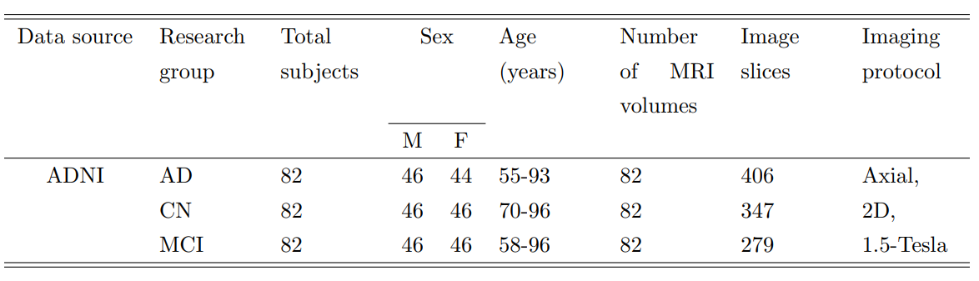
3.1 Dataset
The Alzheimer’s Disease Neuroimaging Initiative (ADNI) dataset
T2-weighted MRI scan (GE medical systems)
DICOM/NIFTI to PNG (256x256)
246 subjects (82 AD, 82 MCI, 82 CN) for training
Manually went through all images to select images with good regions
Validation data consisted of 115 slices (51 AD, 64 CN)
Test data consisted of 10 subjects for each category
Demographic representation of training data
Notes:
Tried entropy based image selection method, based on previous research, but no effective
Currently also working with selecting middle slices

Slide 41
3.2 Data Augmentation
Dealing with data scarcity
Adopted two data augmentation methods for a small dataset with only few MRI scans
Traditional data augmentation
GAN-based augmentation
Notes:
Adopted two data augmentation methods for a small dataset with only few MRI scans
Traditional augmentation (Rotation, width shift, shear, zoom)

Slide 42
3.2 Data Augmentation
Traditional data augmentation
Remove class imbalance
Increase data set for GAN training
Rotation, shear, zoom, shift (translation)
GAN-based image generation
Progressive Growing of GAN with Wasserstein Gradient Penalty¹ (PGGAN-WGP)
Generate same number of images as the original training data
Karras, Tero, et al. "Progressive Growing of GANs for Improved Quality, Stability, and Variation." International Conference on Learning Representations. 2018.

Slide 43
3.2 Data Augmentation
GAN-based image generation
Comparison of RaLSGAN and PGGAN
The ‘Fréchet Inception Distance” (FID)
which captures the similarity of
generated images to real ones.
PGGAN-WP FID score 35-40
Better than RaLSGAN
More realistic
Jolicoeur-Martineau, Alexia. "The relativistic discriminator: a key element missing from standard GAN." arXiv preprint arXiv:1807.00734 (2018).
Karras, Tero, et al. "Progressive Growing of GANs for Improved Quality, Stability, and Variation." International Conference on Learning Representations. 2018.

Slide 44
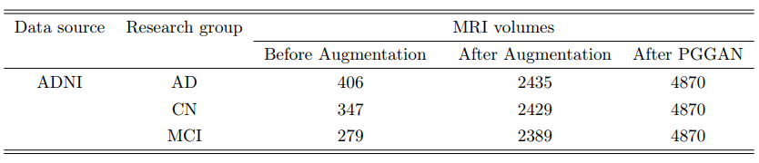
3.2 Data Augmentation
Final data set
Training data set after augmentation

Slide 45
3.3 Comparison of various architectures
Comparison on AD vs. CN classification task
After PGGAN generation, a detailed analysis was made on the AD vs. CN classification accuracy using different architectures.
These architectures include Custom CNN architecture, ResNet¹, Inception model², residual attention network³ , CBAM architecture⁴ and Multi-scale CNN. We also evaluate pretrained models on ImageNet data.
Testing results are reported based on the majority voting decision for the patients.
5x5 conv, 32
5x5 conv, 64
3x3 conv, 128
3x3 conv, 256
3x3 conv, 512
FC1
FC2
FC3
FC4
FC5
Softmax
Input
AvgPool
Custom CNN architecture
He, Kaiming, et al. "Deep residual learning for image recognition." Proceedings of the IEEE conference on computer vision and pattern recognition. 2016.
Szegedy, Christian, et al. "Going deeper with convolutions." Proceedings of the IEEE conference on computer vision and pattern recognition. 2015.
Wang, Fei, et al. "Residual attention network for image classification." Proceedings of the IEEE conference on computer vision and pattern recognition. 2017.
Woo, Sanghyun, et al. "Cbam: Convolutional block attention module." Proceedings of the European conference on computer vision (ECCV). 2018.
Notes:
As a first step, a detailed analysis was made on the AD vs. CN classification accuracy using different architectures.
Wanted to check if only PGGAN is enough, and also verify results of previous research
These architectures include Custom CNN architecture, inception mode, residual attention network}, CBAM architectures and Multi-scale CNN. We also evaluate pretrained models on ImageNet data.
Since the validation data was unseen and novel, all the models were evaluated based on the validation accuracy. Table 3.2 shows a comparison of various architectures.
Testing results are reported based on the majority voting decision for the patients.
All these architectures showed higher accuracy during training. However, the validation accuracy is not very high.
Models were also used to predict the patients using the test data.
Majority voting was used to make and categorize the patients. If a patient has more slices with AD prediction, then the patient was classified as AD. Otherwise, the patient belongs to CN. The best performance was achieved in some cases with 2-3 miss-classifications per category.
The reason can be that these large ImageNet models might be over-parametrized for very small data sets.

Slide 46
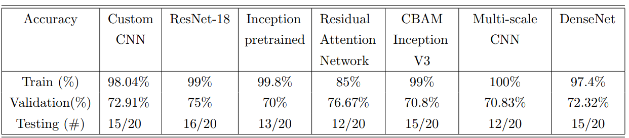
3.3 Comparison of various architectures
Results
Observations
All these architectures showed higher accuracy during training. However, the validation accuracy is not very high.
The best performance was achieved in some cases with 2-3 miss-classifications per category.
The reason can be that these large ImageNet models might be over-parametrized for very small data sets.
Also transfer learning on real-world data is not very effective
Comparison of various architectures for AD vs. CN classification task
He, Kaiming, et al. "Deep residual learning for image recognition." Proceedings of the IEEE conference on computer vision and pattern recognition. 2016.
Szegedy, Christian, et al. "Going deeper with convolutions." Proceedings of the IEEE conference on computer vision and pattern recognition. 2015.
Wang, Fei, et al. "Residual attention network for image classification." Proceedings of the IEEE conference on computer vision and pattern recognition. 2017.
Woo, Sanghyun, et al. "Cbam: Convolutional block attention module." Proceedings of the European conference on computer vision (ECCV). 2018.
Notes:
As a first step, a detailed analysis was made on the AD vs. CN classification accuracy using different architectures.
Wanted to check if only PGGAN is enough, and also verify results of previous research
These architectures include Custom CNN architecture, inception mode, residual attention network}, CBAM architectures and Multi-scale CNN. We also evaluate pretrained models on ImageNet data.
Since the validation data was unseen and novel, all the models were evaluated based on the validation accuracy. Table 3.2 shows a comparison of various architectures.
Testing results are reported based on the majority voting decision for the patients.
All these architectures showed higher accuracy during training. However, the validation accuracy is not very high.
Models were also used to predict the patients using the test data.
Majority voting was used to make and categorize the patients. If a patient has more slices with AD prediction, then the patient was classified as AD. Otherwise, the patient belongs to CN. The best performance was achieved in some cases with 2-3 miss-classifications per category.
The reason can be that these large ImageNet models might be over-parametrized for very small data sets.

Slide 47
3.4 Proposed Architecture
Training Details
System and environment
NVIDIA RTX 2080 Ti GPU.
PyTorch
Model
ResNet-18 with CBAM
SimCLR Pretraining
1000 epochs
Batch size of 128
SGD optimizer
Learning rate of 0.05
Notes:
SimCLR
Also used weight decay and momentum

Slide 48
3.4 Proposed Architecture
Training Details
Classification task
100 epochs
SGD optimizer
Learning rate 0.001
Batch size 128
Notes:
SimCLR pretrained model for AD classification

Slide 49
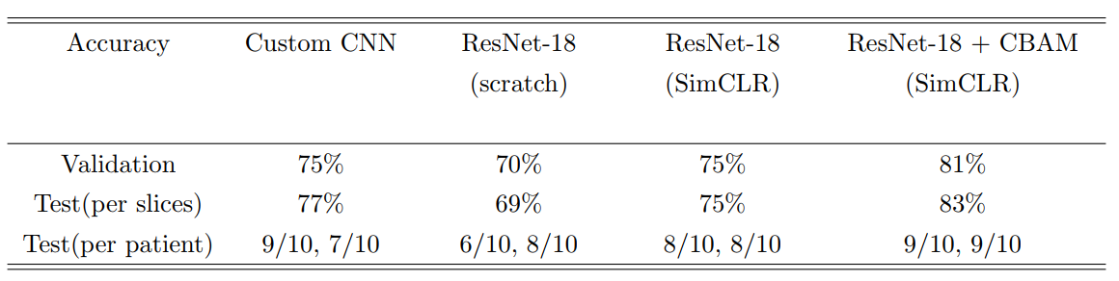
3.5 Results
Two category classification
AD vs. CN classification
We trained our ResNet-18 model for comparison. We also compare results with and without CBAM and SimCLR architectures to highlight their effect. We also compared our model to a custom-designed CNN
When training from scratch, the model seems to overfit and the training process is unstable
However, after pretraining, the model training on classification tasks is more stable and the resulting accuracy also goes up to 75%.
The model performance is further refined when combined with CBAM architecture since the model learns to focus and refine important features
Only 1 misclassification per category
AD vs. CN classification results of proposed framework
Notes:
We trained our ResNet-18 model for comparison. We also compare results with and without CBAM and SimCLR architectures to highlight their effect. We also compared our model to a custom-designed CNN (five convolutional layers and five fully connected layers).
When training from scratch, the model seems to overfit and the training process is unstable. However, after pretraining, the model training on classification tasks is more stable and the resulting accuracy also goes up to 75\%. The model performance is further refined when combined with CBAM architecture since the model learns to focus and refine important features for the classification task.
Only 1 misclassification per category
The main reason is that MCI class is very hard to distinguish from AD and CN classes.
Also, the amount of data is small which can result in poor training of the model.
We also investigated the effect of PGGAN-based medical image generation. The model shows 3-4 misclassifications during the testing phase when trained on data with only traditional data augmentation. Adding PGGAN data increases the amount and also a variety of data which can help the model learn more generalized features.

Slide 50
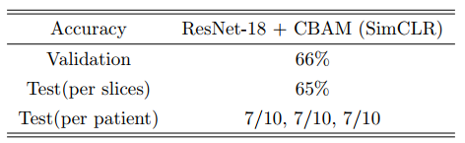
3.5 Results
Three category classification
AD vs. CN vs. MCI classification
Accuracy up to 65%
MCI class is very hard to distinguish from AD and CN classes.
AD vs. CN vs. MCI classification results of proposed framework
Notes:
The main reason is that MCI class is very hard to distinguish from AD and CN classes.
Also, the amount of data is small which can result in poor training of the model.
We also investigated the effect of PGGAN-based medical image generation. The model shows 3-4 misclassifications during the testing phase when trained on data with only traditional data augmentation. Adding PGGAN data increases the amount and also a variety of data which can help the model learn more generalized features.

Slide 51
3.6 Comparison with existing methods
Study | Total Subjects | Performance | Approach | Data Leakage
Aderghal et al., 2017 Cheng and Liu, 2017 Korolev et al., 2017 Valliani and Soni, 2017 Senanayake et al., 2018 Li et al., 2017 Basaia et al., 2019 Hon and Khan, 2017 Hosseini et al., 2018 Lin et al., 2018 Taqi et al., 2018 Vu et al., 2017 Vu et al., 2018 Wang et al., 2019 Basheera et al., 2019 Proposed | 815 (T1 MRI) 193 (T1 MRI + PET) 231 (T1 MRI) 417 (T1 MRI) 515 (T1 MRI) 427 (T1 MRI) 646 (T1 MRI) 416 (T1 MRI) 140 (T1 MRI) 417 (T1 MRI) 400 (T2 MRI) 317 (T1 MRI) 400 (T1 MRI) 400 (T1 MRI) 242 (T2 MRI) 164 (T2 MRI) | ACC=0.84 ACC=0.85 ACC=0.80 ACC=0.81 ACC=0.76 ACC=0.88 ACC=0.99 ACC=0.96 ACC=0.99 ACC=0.89 ACC=1.00 ACC=0.85 ACC=0.86 ACC=0.99 ACC=1.00 ACC=0.83 | ROI-based 3D subject-level 3D subject-level 2D slice-level 3D subject-level 3D patch-level 3D subject-level 2D slice-level 3D subject-level ROI-based 2D slice-level 3D subject-level 3D subject-level 3D subject-level 2D slice-level 2D slice-level | None None None None None None Unclear (b) Unclear (a, c) Unclear (a) Unclear (b) Unclear (b) Unclear (a) Clear (a, c) Clear (b) Clear (b) None
Types of data leakage
a: wrong data split; b: absence of independent test set; c: late split
Comparison of AD vs. CN classification task
Wen, Junhao, et al. "Convolutional neural networks for classification of Alzheimer's disease: Overview and reproducible evaluation." Medical image analysis 63 (2020): 101694.
Notes:
Most of these approaches used large data sets
Have data leakage issue
When I surveyed, I realized that most of these approaches does not have proper evaluation and separate validation and test data
It is just like reporting training accuracy
Also one of the reason I trained so many models to confirm
Even with small data and very few slices, our approach achieves good results
In our approach, we avoided all kinds of data leakage and provided an unbiased evaluation of our model which is very important for clinical applications. Our model achieves comparable results to the past approaches even with a very small data set.

Slide 52
3.6 Comparison with existing methods
Observations
Most of these approaches have data leakage
They used large datasets (more number of subjects)
T1-weighted has more slices compared to T2-weighted
Most of these approaches does not have proper evaluation and separate validation and test data
It is just like reporting training accuracy
Even with small data and very few slices, our approach achieves good results
In our approach, we avoided all kinds of data leakage and provided an unbiased evaluation of our model which is very important for clinical applications
Wen, Junhao, et al. "Convolutional neural networks for classification of Alzheimer's disease: Overview and reproducible evaluation." Medical image analysis 63 (2020): 101694.
Notes:
Most of these approaches used large data sets
Have data leakage issue
When I surveyed, I realized that most of these approaches does not have proper evaluation and separate validation and test data
It is just like reporting training accuracy
Also one of the reason I trained so many models to confirm
Even with small data and very few slices, our approach achieves good results
In our approach, we avoided all kinds of data leakage and provided an unbiased evaluation of our model which is very important for clinical applications. Our model achieves comparable results to the past approaches even with a very small data set.

Slide 53
3.6 Comparison with existing methods
Types of data leakage
a: wrong data split; b: absence of independent test set; c: late split
Only one approach without data leakage
Study | Total Subjects | Performance | Approach | Data Leakage
Valliani and Soni, 2017 Hosseini et al., 2018 Farooq et al., 2017 Vu et al., 2018 Wang et al., 2019 Basheera et al., 2019 Proposed | 660 (T1 MRI) 210 (T1 MRI) 355 (T1 MRI) 615 (T1 MRI) 624 (T1 MRI) 349 (T2 MRI) 246 (T2 MRI) | ACC=0.57 ACC=0.97 ACC=0.99 ACC=0.80 ACC=0.97 ACC-0.86 ACC=0.65 | 2D slice-level 3D subject-level 2D slice-level 3D subject-level 3D subject-level 2D slice-level 2D slice-level | None Unclear (a) Clear (a, c) Clear (a, c) Clear (b) Clear (b) None
Comparison of AD vs. CN vs. MCI classification task
Wen, Junhao, et al. "Convolutional neural networks for classification of Alzheimer's disease: Overview and reproducible evaluation." Medical image analysis 63 (2020): 101694.
Notes:
Only one approach

Slide 54
4. Conclusion and Future Work

Slide 55
4. Conclusion
Achieved good results despite small dataset
Two-category: 83% accuracy
Three-category: 65% accuracy
Good performance even with small dataset

Slide 56
4. Conclusion
Contributions
Proposed a novel framework for the AD classification task
ResNet-18 + CBAM
Self-supervised pretraining
Dealt with medical data scarcity
PGGAN based image synthesis
Novel diseases
Proper unbiased evaluation
Separate test and validation data
Application of SimCLR to AD classification
An analysis of various approaches and architectures

Slide 57
4. Future Work
Improving results
Three category classification
Test model with large data sets and other modalities
PET, cognitive scores, APOE genotype, CSF biomarkers, demographic data etc.
Working with further preprocessing techniques
FMRIB Software Library
FreeSurfer
Skull stripping, segmentation, bias correction etc.
Alzheimer disease prediction
Diagnosis of other types of dementia
Vascular dementia, Frontotemporal dementia, Dementia with Lewy bodies
Notes:
- The apolipoprotein E (APOE) genotype is a genetic risk factor for dementia, Alzheimer's disease, and cardiovascular disease (CVD). It includes three alleles (e2, e3, e4) that are located on chromosome 19q3

Slide 58
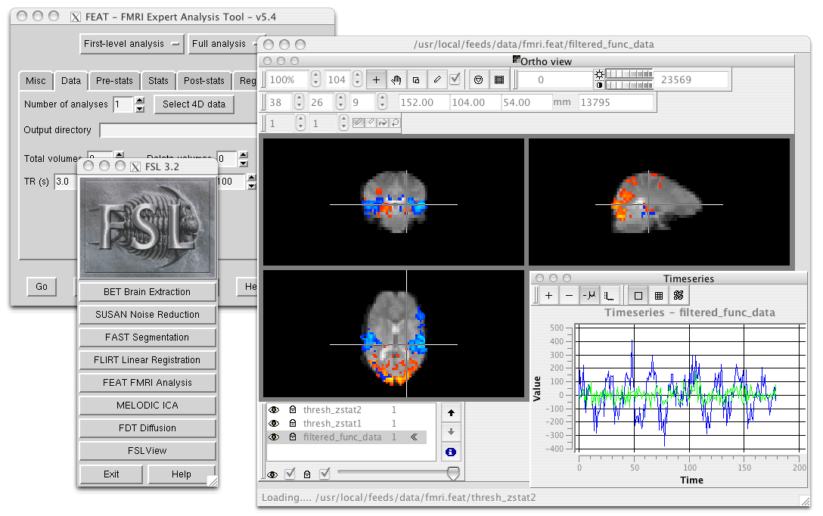
4. Future Work
FMRIB Software Library (FSL)
Skull stripping, bias correction etc.

Slide 59
Thank you!

